Slide 1
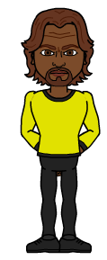
EECT 101-50C Lab Notebook
ELECTRONIC PROJECTS
Fall 2015
Olivia Koehler
12-16-15

Slide 2
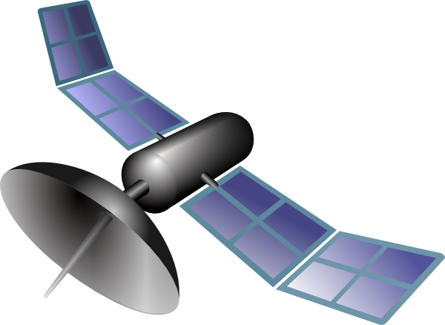
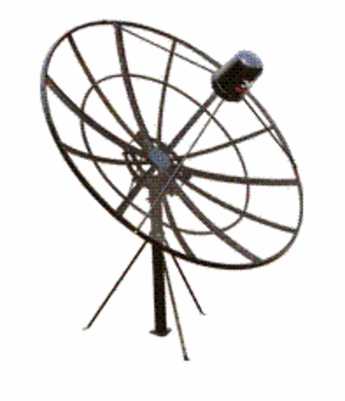
Table of Contents
Lab 1 – Test Equipment and Resistors 3
Lab 2 – Resistors and Ohm’s Law 10
Lab 3 – Resistors and Multisim 18
Lab 4 – Test Equipment Basics 28
Lab 5 – Capacitors, Inductors 37
Lab 6 – Learn to Solder 45
Lab 7 – Component Identification/First Solder Kit 50
Lab 8 – 555 Timer Chip 57
Lab 9 – Filters 65
Lab 10 – Square Wave to Sine Wave 72
Lab 11 – Troubleshoot Home Electronics/Test TTL Chips 77
Lab 12 – Lissajous Pattern 83
Lab 13 – AC to DC Power Supplies 90
Lab 14 – ESD Precautions/Test LEDs 99
Lab 15 – Plan/Prepare/Test Solder Kit 108
Lab 16 – Final Solder Kit 114

Slide 3
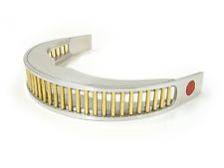
Lab 1 – Test Equipment & Resistors

Slide 4
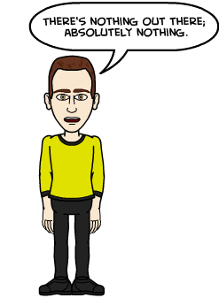
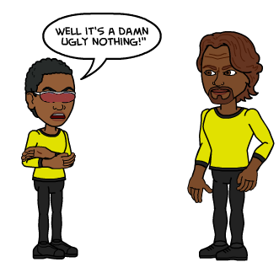
Lab 1 – Test Equipment & Resistors
Objective
    1. To understand what a resistor is.
    2. To learn the purpose of color codes.
Equipment and Material
    MultiMeter: Gw Instek GDM-8245 SN: CL860260
    Handheld Meter: OTE INSTRUMENTS SN: DT-6830

Slide 5
Lab 1 – Test Equipment & Resistors
Research and Information
  http://www.allaboutcircuits.com/textbook/reference/chpt-2/resistor-color-codes/ - (Value of Red Band Tolerance.)
  https://www.youtube.com/watch?v=kvQBhXo_tF0 – (Resistor Color Codes.)
  https://www.youtube.com/watch?v=HrZZMhWZiFk – (Resistors.)

Slide 6

Lab 1 – Test Equipment & Resistors
Procedure
Received three resistors with varying values; R1, R2, and R3.
Following the color code rules, I determined the approximate value of each resistor.
Using a Multimeter, I measured the resistance values of all resistors.
Using Excel, I was able to find whether or not the resistors were within their tolerance ranges;
with the true or false equation.

Slide 7
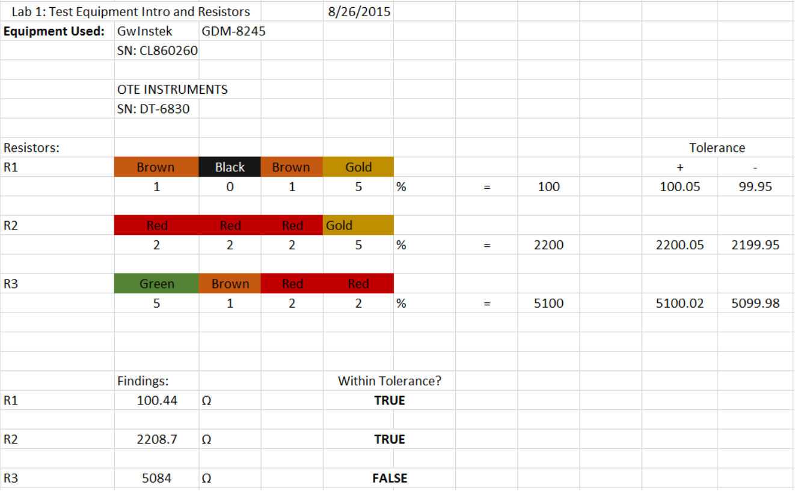
Lab 1 – Test Equipment & Resistors
Excel

Slide 8
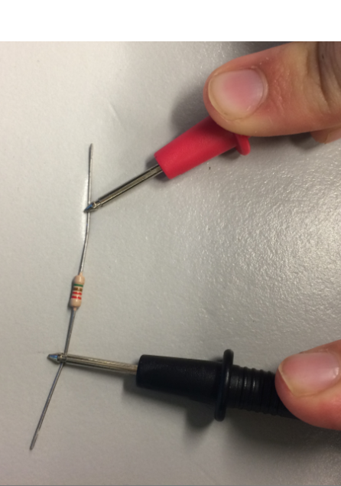
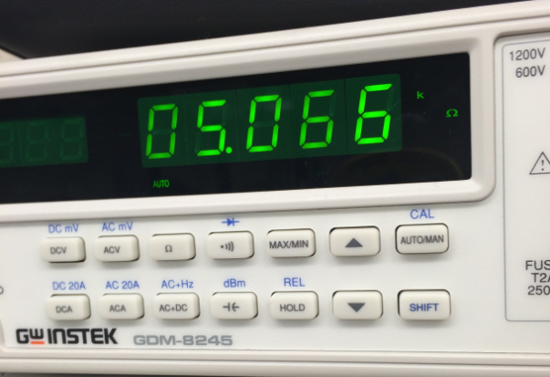
Lab 1 – Test Equipment & Resistors
Testing
Resistor
  Pictures

Slide 9
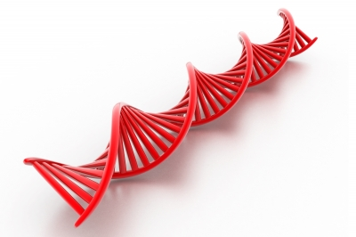
Lab 1 - Test Equipment & Resistors
  Conclusion
  - I learned how the resistor color-code system works, and how to calculate their values.
  - Everything worked just fine, the only issue found was a resistor which was below the nominal.

Slide 10

Lab 2 – Resistors and Ohm’s Law

Slide 11
Lab 2 – Resistors and Ohm’s Law
Objective
    1. To understand how resistors work in Series and Parallel
    2. To learn how to use a Multimeter to measure V,I and R on a bread board.
Equipment and Material
    5 different resistors
    MultiMeter: Gw Instek GDM-8245 SN: CL860260
    DC Power Supply: RSR HY1502D SN: 022510041

Slide 12
Lab 2- Resistors and Ohm’s Law
Research and Information
  https://www.youtube.com/watch?v=d34-VKc2cyY - (Ohm's Law, The Basics.)
  https://www.youtube.com/watch?v=KK5pxJxxyA0 – (Series Circuit Analysis part 1.)
  https://www.youtube.com/watch?v=s9vpe5a9LIE – (Series Circuit Analysis part 2.)
https://www.youtube.com/watch?v=ruRnqmQ5HIE – (Series Circuit Analysis part 3.)
https://www.youtube.com/watch?v=pZSI0O2naLY - (Analyzing a Series-Parallel Circuit.)
https://www.youtube.com/watch?v=qJZCHExi4Pk – (Ohm's Law Calculations for Simple Circuits.)

Slide 13
Lab 2 – Resistors and Ohm’s Law
Procedure
Received five resistors with varying values. Using various combinations, placed them in a bread bored and measured IT, VT and RT.
The two types of circuits made were series and parallel. Each set was made up of first three resistors and then five.
For each set I measured IT and RT with the aid of a multimeter. Only for series did I measure the voltage points for each resistor. (This was because voltage is the same throughout a parallel circuit.)
Using Excel, I proved using ohms law that the measurements taken in the real world were accurate.

Slide 14
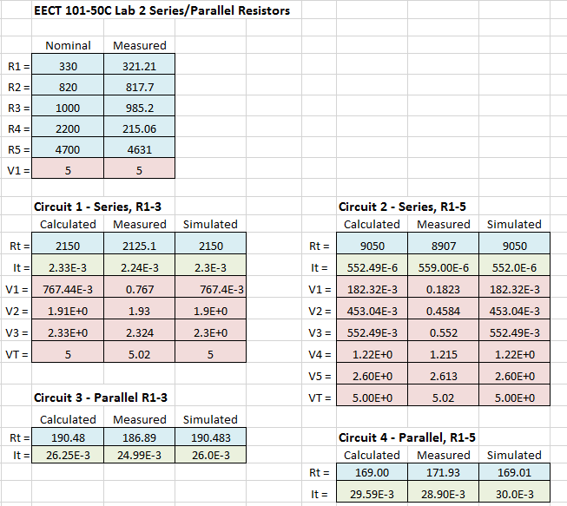
Lab 2 – Resistors and Ohm’s Law
Excel

Slide 15
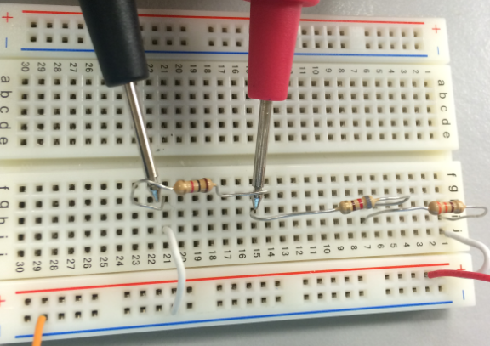
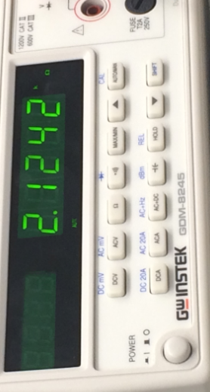
Lab 2 – Resistors and Ohm’s Law
Pictures

Slide 16
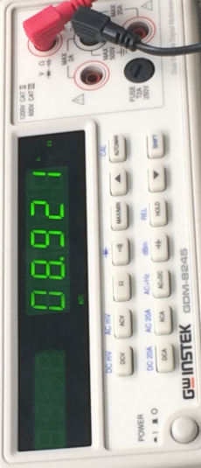
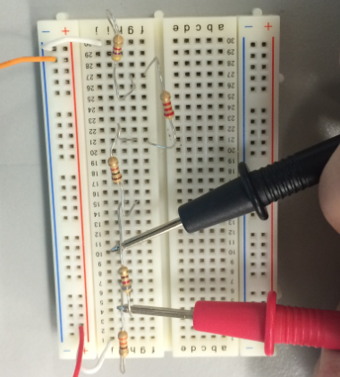
Lab 2 – Resistors and Ohm’s Law
Pictures

Slide 17
Lab 2 – Resistors and Ohm’s Law
Conclusion
  - I learned how current, resistance and voltage all relate to one another in a circuit.
  - The only issue had, was one misplaced wire. Once the problem was resolved everything ran accordingly.
  - If I had to practice any one thing, it would be making sure my wires are lined up with the correct columns.

Slide 18
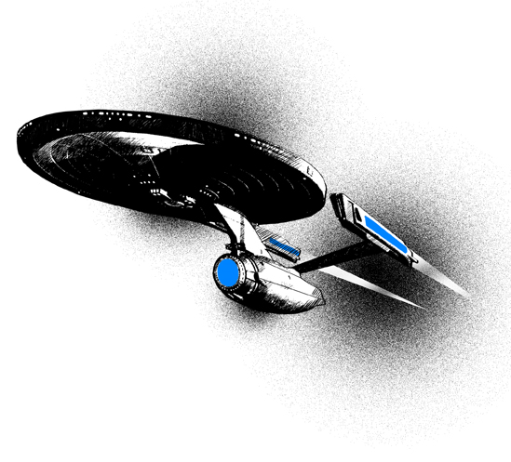
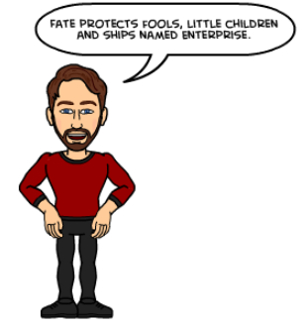
Lab 3 – Resistors and Multisim

Slide 19

Lab 3 – Resistors and Multisim
Objective
    1. To become familiar with Multisim.
    2. To learn how to calculate equivalent resistance for both series and parallel circuits.
    Equipment and Material
    Multisim

Slide 20
Lab 3 – Resistors and Multisim
Research and Information
  https://www.youtube.com/watch?v=10Rt2p3seV4 - (MultiSim 101.)
  https://www.youtube.com/watch?v=2UQPd0pj6uc– (MultiSim 102.)
  https://www.youtube.com/watch?v=3G5V0Hxjkbg– (Measure R with an ohmmeter.)
https://www.youtube.com/watch?v=8P4oFw6sIzQ– (Measure DC V with a voltmeter indicator.)
https://www.youtube.com/watch?v=8h2SAZ9gkBA - (Measure DC I with an ammeter indicator.)

Slide 21
Lab 3 – Resistors and Multisim
Procedure
Learn and understand all of the different ways Multisim can be utilized.
Using the same value of resistors from the previous lab, create multiple circuits.
Take readings from each circuit made recording V, R, and I.
Compare the result from multisim to the results received from Lab 2.

Slide 22
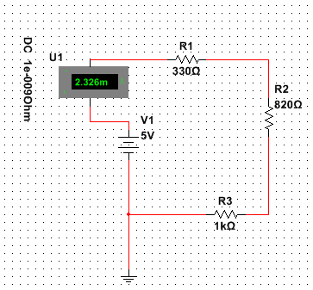
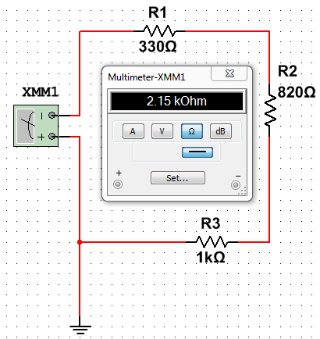
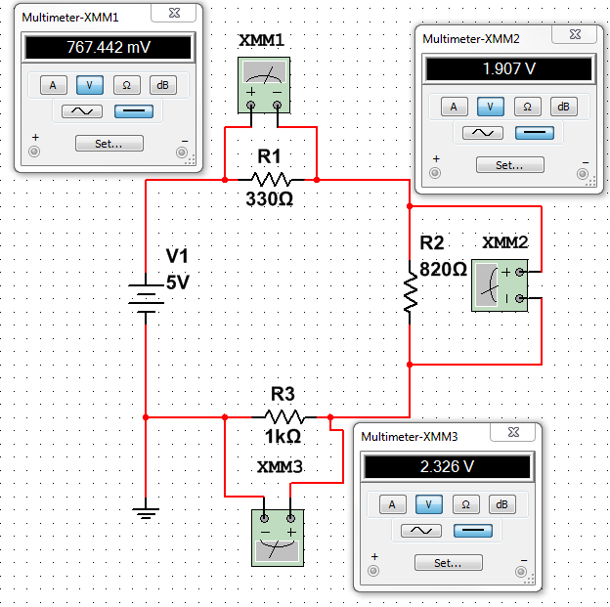
Lab 3 – Resistors and Multisim
Multisim
Series R1, R2, R3
IT
RT
V123

Slide 23
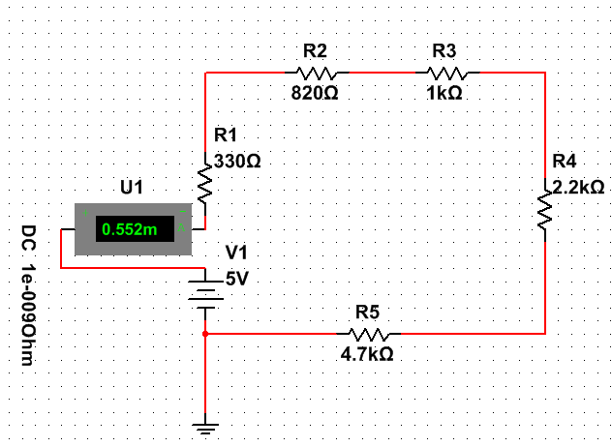
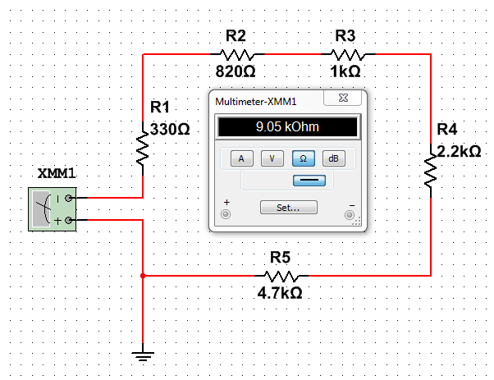
Lab 3 – Resistors and Multisim
Multisim
Series R1, R2, R3, R4, R5
IT
RT

Slide 24
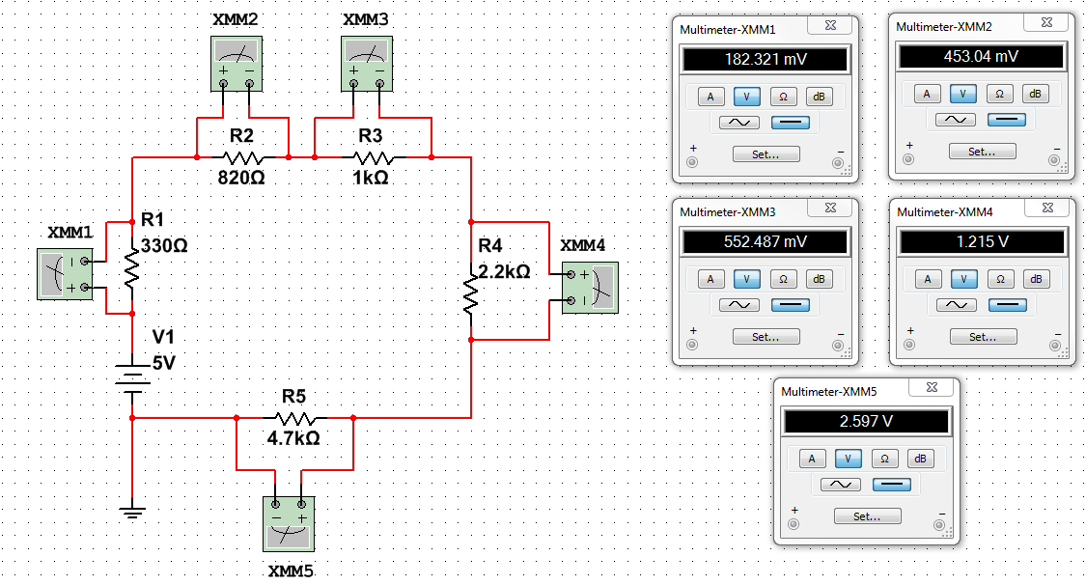
Lab 3 – Resistors and Multisim
Multisim
Series R1, R2, R3, R4, R5
V12345

Slide 25
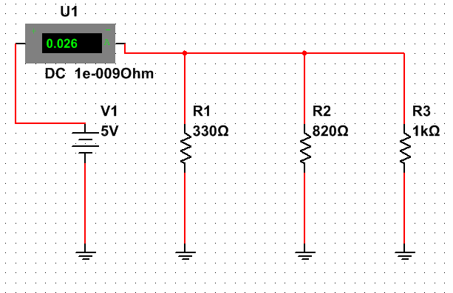
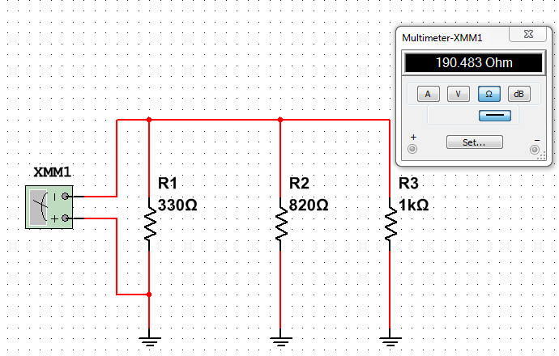
Lab 3 – Resistors and Multisim
Multisim
Parallel R1, R2, R3
IT
RT

Slide 26
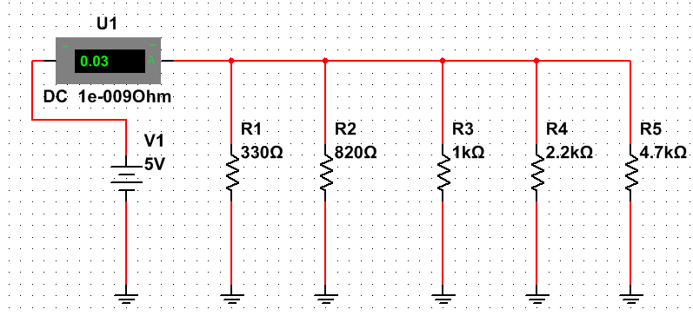
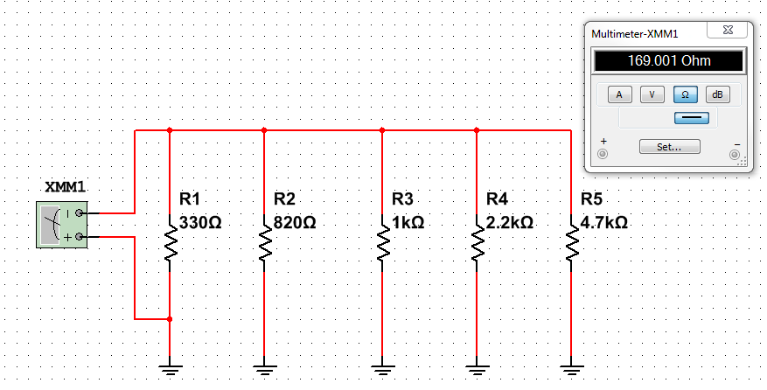
Lab 3 – Resistors and Multisim
Multisim
Parallel R1, R2, R3, R4, R5
IT
RT

Slide 27

Lab 3 – Resistors and Multisim
Conclusion
  I learned how there are many different ways to do one thing in Multisim. Some being easier to use then others. I also learned that I can use Multisim to check my circuits created in the “real world”.
  - I had no issues using Multisim.

Slide 28

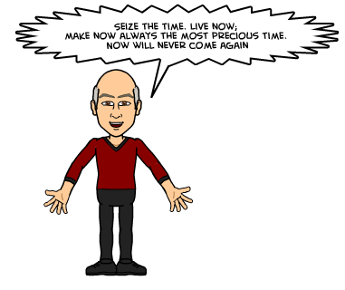
Lab 4 – Test Equipment Basics

Slide 29
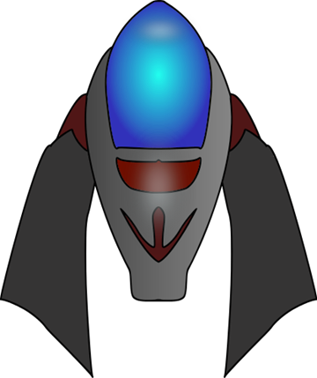
Lab 4 – Test Equipment Basics
Objective
    1. To understand how to use an oscilloscope and function generator.
    2. To learn how to take proper readings from an oscilloscope in conjunction with a function generator.
Equipment and Material
    Oscilloscope: Tektronix TDS-220 SN: B083238
    Function Generator: Gw Instek GFG-8210 SN: C705255

Slide 30
Lab 4 – Test Equipment Basics
Research and Information
  https://www.youtube.com/watch?v=dBVWv7enDsU- (Use of Basic Laboratory Equipment
  0-Scope.)
  https://www.youtube.com/watch?v=Zink6v6TXk4– (Use of Basic Laboratory Equipment
  F-Generator.)
  https://www.youtube.com/watch?v=dTPHSDoWKU0– (Test Equipment- The O-Scope.)
https://www.youtube.com/watch?v=7nwIIPN9QEY– (Tektronix Tutorial Part 1.)
https://www.youtube.com/watch?v=8VEg6L2QG5o- (AC vs DC Explained.)
https://www.youtube.com/watch?v=OFGm-Pel4Hg– (Triggering controls and their usage.)

Slide 31
Lab 4 – Test Equipment Basics
Procedure
A function generator and an oscilloscope were hooked together.
Following the directions given, changed the settings on the function generator and observed the readings from the oscilloscope.
As the readings would change and/or needed to be adjusted to meet the parameters of the experiment, the readings were recorded.

Slide 32
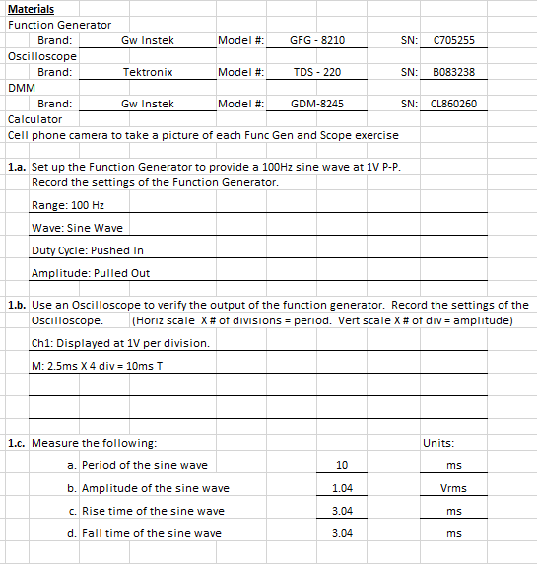
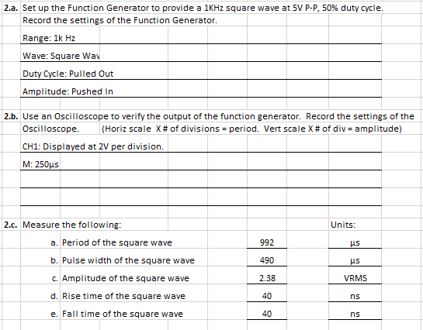
Lab 4 – Test Equipment Basics
Excel

Slide 33
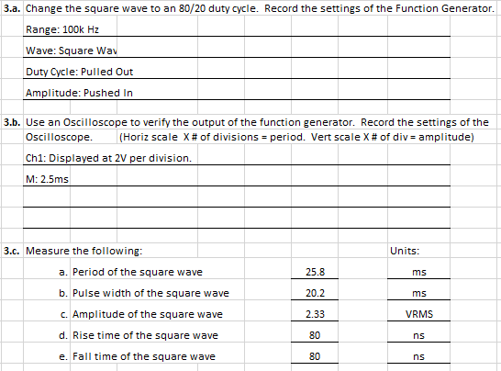
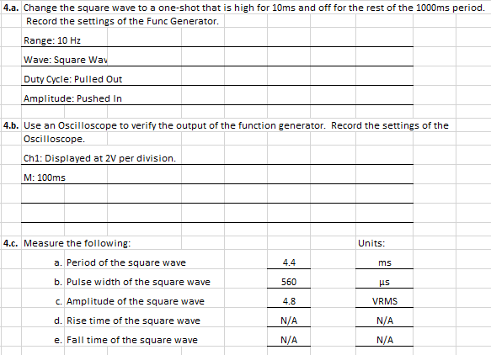
Lab 4 – Test Equipment Basics
Excel

Slide 34
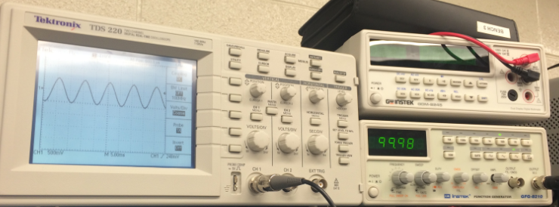
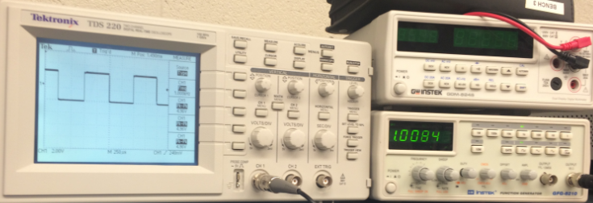
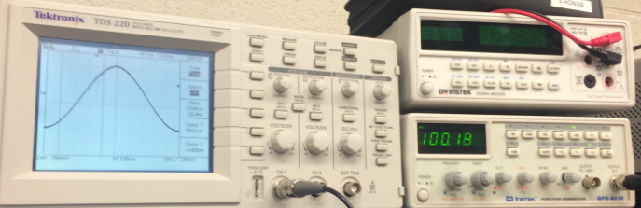
Lab 4 – Test Equipment Basics
Pictures

Slide 35
Lab 4 – Test Equipment Basics
Conclusion
  I learned how the different controls on a function generator effect the outcome of what appears on the oscilloscope screen. Also, I learned how to use the cursors on the oscilloscope to take readings from the screen.
  - I did have trouble adjusting the function generator to get the readings I needed from the oscilloscope, however with much practice I feel more comfortable with the unit.

Slide 36
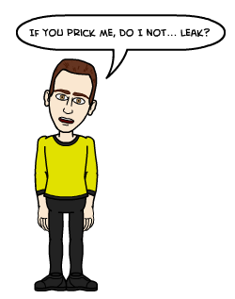
Lab 5 – Capacitors, Inductors

Slide 37

Lab 5 – Capacitors, Inductors
Objective
    To under stand LCR meter and how to measure inductors and capacitors including custom hand-wound inductors.
    To learn how to run and LCR meter, and take readings from one.
Equipment and Material
    4 Capacitors: 4.7pF, 0.0033uF, 0.01uF, and electrolytic 4.7uF
    3 Inductors: 100uH, 22mH, and 100mH
    3 Custom Wound Inductors: T68 core w/ 10 turn, T68 core w/ 15 turns, and T80 core w/ 20 turns
    LCR Meter: LCR-819 SN:GEN220267
    Bench 1- Caliper

Slide 38
Lab 5 – Capacitors, Inductors
Research and Information
  https://www.youtube.com/watch?v=X707xxqB1Qc - (What is a Capacitor? P1.)
  https://www.youtube.com/watch?v=gOwJLgjRtw8 – (What is a Capacitor? P2.)
  https://www.youtube.com/watch?v=t9Qwx75eg8w– (How a Capacitor Works.)
https://www.youtube.com/watch?v=WKFnuHfmx00– (What is an Inductor? P1.)
https://www.youtube.com/watch?v=rqvqIQSBZc8 - (What is an Inductor? P2.)
https://www.youtube.com/watch?v=NgwXkUt3XxQ – (Inductor basics.)

Slide 39
Lab 5 – Capacitors, Inductors
Procedure
Using and LCR meter measure the values of 4 different caps and 3 different inductors.
Hand wound 3 different inductors using 28AWG magnet wire, and calculated possible values using excel.
Measured the hand wound inductors, and compared them to excel equations.

Slide 40
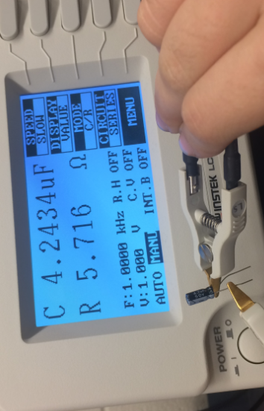
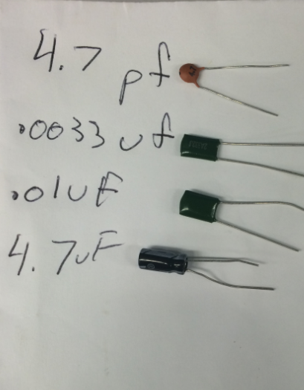
Lab 5 – Capacitors, Inductors
Pictures
Capacitor

Slide 41
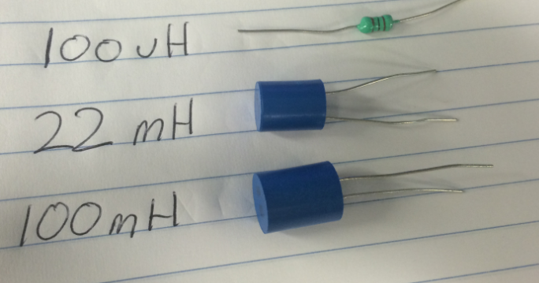
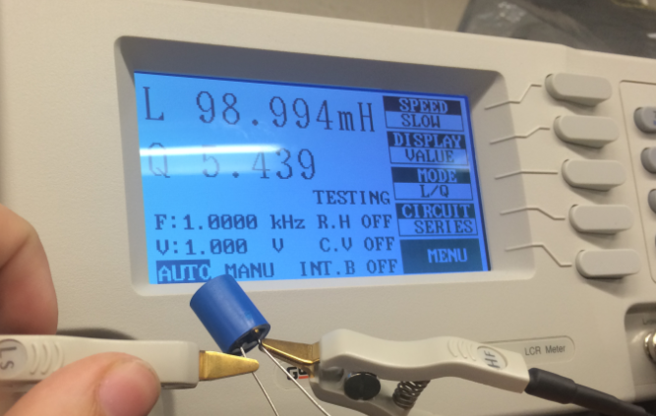
Lab 5 – Capacitors, Inductors
Pictures
Inductor

Slide 42
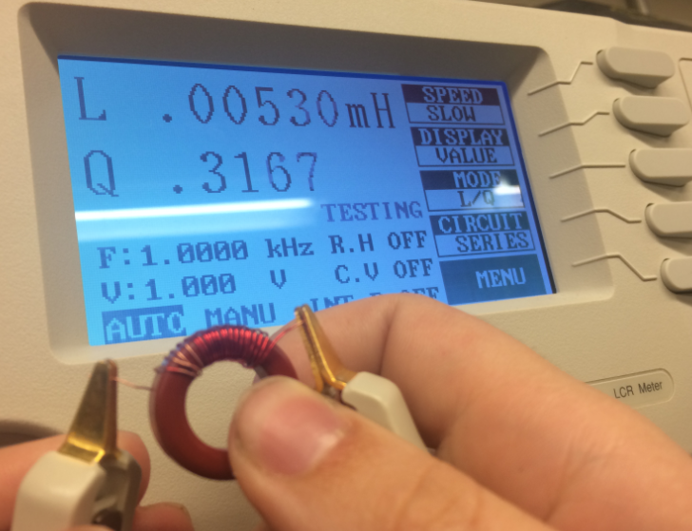
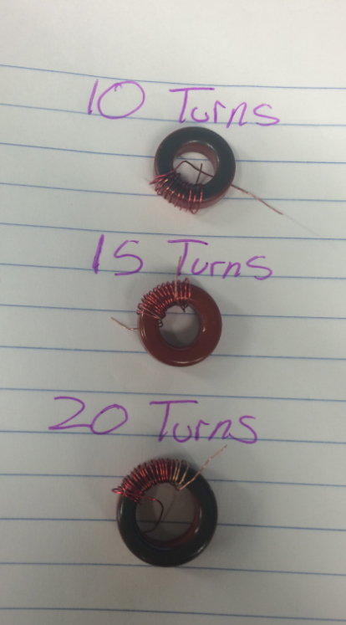
Lab 5 – Capacitors, Inductors
H
A
N
D
Pictures
W
O
U
N
D

Slide 43

Lab 5 – Capacitors, Inductors
Conclusion
  I learned how to calculate an inductors value using its permeability.
  - I did have some trouble with the equation, however it was a simple solution to an easy mistake.

Slide 44

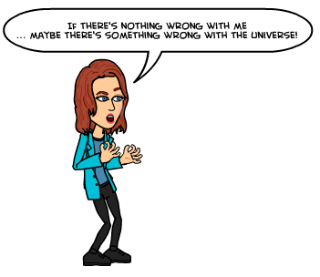
Lab 6 – Learn to Solder

Slide 45

Lab 6 – Learn to Solder
Objective
Practice soldering components to a board.
Equipment and Material
Soldering Machine: (WES51)

Slide 46
Lab 6 – Learn to Solder
Research and Information
https://www.youtube.com/watch?v=vIT4ra6Mo0s - Solder & Flux
https://www.youtube.com/watch?v=Q9G9gaokqvM - Joining Stranded Wires
https://www.youtube.com/watch?v=oqV2xU1fee8 - How to Solder
https://www.youtube.com/watch?v=-lnRf2biz50 -Removing solder
https://www.youtube.com/watch?v=j1ZnkTC5bps - How to tin a soldering iron tip
https://www.youtube.com/watch?v=BxeDkcAa4Fs - The Basics

Slide 47

Lab 6 – Learn to Solder
Procedure
Using twelve different components, we identified each one.
After identifying the components, each one was soldered to the board.

Slide 48
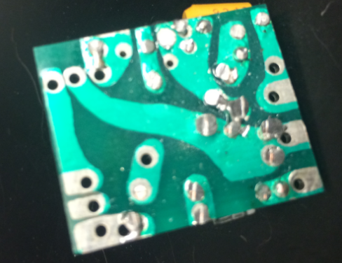
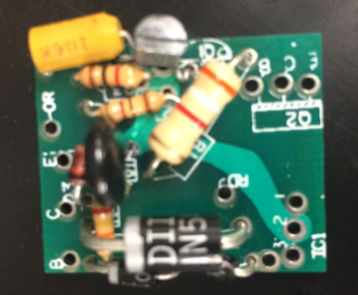
Lab 6 – Learn to Solder
Capacitor
Semiconductor
Pictures
Diode
Resistors
VaResistor
Capacitors

Slide 49

Lab 6 – Learn to Solder
Conclusion
  I learned how to solder components to a board.
  - I also learned how to use data sheets to identify components which may be unknown.

Slide 50
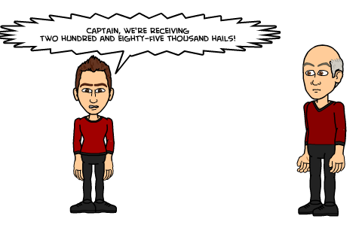
Lab 7 -Component Identification & Solder Kit

Slide 51
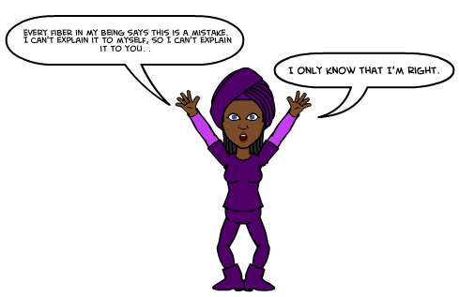
Lab 7 -Component Identification & Solder Kit
Objective
- To identify all the different components given in a soldering kit.
- On a CD-1 board, one must identify the two families of ICs used and what the various suffixes mean.
Equipment used
Solder Machine: (WES51)

Slide 52
Lab 7 -Component Identification & Solder Kit
Research and Information
http://www.howtogeek.com/63630/how-to-use-a-soldering-iron-a-beginners-guide/ (Beginning solder)
https://mightyohm.com/files/soldercomic/FullSolderComic_EN.pdf (solder is easy)
http://www.build-electronic-circuits.com/how-to-solder/ (How to solder)

Slide 53
Lab 7 -Component Identification & Solder Kit
Procedure
1. Document the quantity of each type of component. On the CD-1 board, identify the two families of ICs used and what the various suffixes mean.
2. Evaluate the impact of removing middle breadboard screws and how to lower 4 corner countersunk screws flush to the top for placement of new breadboard on top using strong adhesive tape.

Slide 54
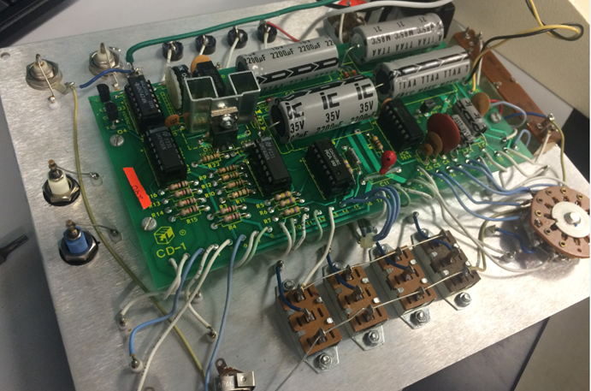
Lab 7 -Component Identification & Solder Kit
Diode
Pictures
Electrolytic Capacitor
Semiconductor
IC
Disc Capacitor
Resistor

Slide 55
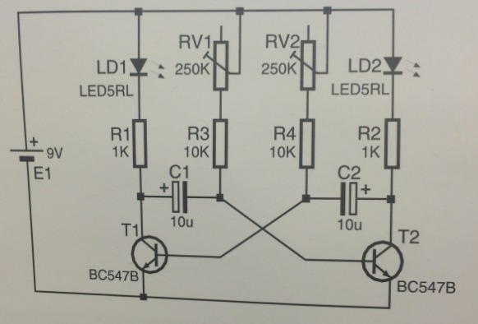


Lab 7 -Component Identification & Solder Kit
Pictures

Slide 56

Lab 7 -Component Identification & Solder Kit
Conclusion
- All of the components were identified and soldered to the board.
- Even though I am still new to soldering I have come a long way sense my first time soldering.

Slide 57


Lab 8- 555 Timer Chip

Slide 58

Lab 8- 555 Timer Chip
Objective
- To research the 555 Timer chip, and breadboard two types of LEDs creating a typical flashing circuit for the following values: 0.5Hz, 1Hz, 4Hz.
Equipment used
Oscilloscope: TDS-220 SN:B083238
DC Power Supply: HY1802D SN:022510041

Slide 59

Lab 8- 555 Timer Chip
Research and Information
https://en.wikipedia.org/wiki/555_timer_IC (Info on timer)
http://www.electronics.dit.ie/staff/mtully/555%20folder/555%20timer.htm (the 555 timer)

Slide 60
Lab 8- 555 Timer Chip
Procedures
1. Find formula online to set frequency and use Excel to calculate values needed for the 3 frequencies.
2. Use an oscilloscope to verify all 3 frequencies by calculating the frequency from the period.
3. Record all measurements on worksheet and answer all questions.

Slide 61


Lab 8- 555 Timer Chip
Work Sheet

Slide 62

Lab 8- 555 Timer Chip
Work Sheet

Slide 63


Lab 8- 555 Timer Chip
Pictures

Slide 64

Lab 8- 555 Timer Chip
Summary
Hooking up the circuit was fairly simple, especially after looking up the 555 timer data sheet. I am still getting used to operating the oscilloscope, however getting the readings I needed came pretty easily.

Slide 65


Lab 9- Filters

Slide 66

Lab 9- Filters
Objective
- To research RC electronic filters.
To build an RC low pass filter and measure the frequency response from 10 Hz to 100,000 Hz.
Also, to plot Vout vs. Freq in Excel and find the cutoff frequency fc and indicate on the plot using a text box and arrow.
Equipment used
Oscilloscope: (TDS-220 SN:B083238)
LCR Meter: (LCR-819 SN:GEN220267)
Multimeter: (GDM-8245 SN:CL860260)

Slide 67
Lab 9- Filters
Research and Information
http://www.niu.edu/~mfortner/labelec/lect/p575_07a.pdf (Filters Circuits)
http://www.dummies.com/how-to/content/making-lowpass-and-highpass-filters-with-rc-circui.html (Low Pass & High Pass)

Slide 68

Lab 9- Filters
Procedures
Build an RC low pass filter.
Measure the frequency response from 10 Hz to 100,000 Hz.

Slide 69



Lab 9- Filters
Pictures

Slide 70

Lab 9- Filters
Summary
I learned how to properly hook up an RC circuit, and how to properly hook up all of the wires.

Slide 71


Lab 10 - Square Wave to Sine Wave

Slide 72
Lab 10 - Square Wave to Sine Wave
Objective
1. Research a way to convert a square wave to a sine wave using only resistors and capacitors (R and C), then build and demonstrate in the lab.
2.To get an output signal that looks close in shape to a sine wave with at least a 500mVp-p amplitude.
Equipment used
Oscilloscope: (TDS-220 SN:B083238)
Function Generator: (GFG-8210 SN:C705255)
DC Power Supply: (HY1802D SN:022510041)

Slide 73
Lab 10 - Square Wave to Sine Wave
Research and Information
http://www.ti.com/lit/an/sbfa003/sbfa003.pdf (Square to Sine)
http://www.instructables.com/answers/turn-a-square-wave-froma-555-into-a-sine-wave/ (Instructorless)
http://forum.allaboutcircuits.com/threads/square-wave-to-sine-wave-conversion.32396/ (All about circuits)

Slide 74
Lab 10 - Square Wave to Sine Wave
Procedure
Use a function generator for the input and set it for a square wave at 100 Hz and 5V amplitude with a 50% duty cycle.
Use an oscilloscope to display the input square wave on Channel 1 and the output sine wave on Channel 2.
The square wave should show little or no degradation when displayed on the scope, i.e. no curving or rounding on the top or bottom.

Slide 75



Lab 10 - Square Wave to Sine Wave
Pictures

Slide 76

Lab 10 - Square Wave to Sine Wave
Summary
I learned how to change a square wav into a sign wave with the aid of capacitors. Not an easy task, especially looking for help online, however the circuit was success.

Slide 77


Lab 11 – Troubleshoot Home Electronics

Slide 78

Lab 11 – Troubleshoot Home Electronics
Objective
- Breadboard a test circuit to test one chip at a time using 74LS series TTL chips from parts bin.
- Troubleshoot and fix home electronics.
Equipment used
Digital Multimeter: (GDM-8245 SN: CL860260)

Slide 79
Lab 11 – Troubleshoot Home Electronics
Research and Information
https://www.facstaff.bucknell.edu/mastascu/eLessonsHTML/Labs/Logic/LabLogic1A.html (Logic Lab)
http://www.instructables.com/id/FAN-repair/ (Fan Repair)

Slide 80
Lab 11 – Troubleshoot Home Electronics
Procedures
Open Fan and test motor using a multi meter.
Check when fan is running, does it over heat? Does it make any noise?
Test axel to make sure it still works.
Come up with a solution to the problem.

Slide 81



Lab 11 – Troubleshoot Home Electronics
Pictures
IC Test
Circuit
Home
Electronic

Slide 82
Lab 11 – Troubleshoot Home Electronics
Summary
I took the fan apart and had to clean it because it was very dusty. The problem to begin was, was that the fan didn’t work what so ever.
Cleaning it did not change anything, and after testing the switch, we found the switch still worked.
The fan continued to make weird noises, after doing many tests it was time to wait and continue the next week.

Slide 83

Lab 12-Lissajous Pattern/Misc Troubleshooting/Test TTL Chips

Slide 84

Lab 12-Lissajous Pattern/Misc Troubleshooting/Test TTL Chips
Objective
1. Research a way to display a circle or ellipse on an oscilloscope.
2. Test circuit to test one chip at a time using 74LS00 series TTL chips.
3. Troubleshoot and fix home electronics.
Equipment Used
Oscilloscope: (TDS-220 SN: B083238)
Function Generator: (GFG-8210 SN:C705255)
Digital Multimeter: (GDM-8245 SN: CL860260)

Slide 85
Lab 12-Lissajous Pattern/Misc Troubleshooting/Test TTL Chips
My research Information
http://www.ivytechengineering.com/stores/74ls/files/74ls02.pdf (DATA Sheet)
https://www.picotech.com/library/oscilloscopes/xy-display-mode (XY Display Mode)
http://mathworld.wolfram.com/LissajousCurve.html (Lissajous Curve)

Slide 86
Lab 12-Lissajous Pattern/Misc Troubleshooting/Test TTL Chips
Procedures
Demonstrate a way to display a circle on an oscilloscope, using reference material.
Breadboard a test circuit to test one chip at a time using 74LS00 series TTL chips from untested parts bin
Troubleshoot and fix home electronics.

Slide 87



Lab 12-Lissajous Pattern/Misc Troubleshooting/Test TTL Chips
Pictures

Slide 88

Lab 12-Lissajous Pattern/Misc Troubleshooting/Test TTL Chips
Pictures

Slide 89
Lab 12-Lissajous Pattern/Misc Troubleshooting/Test TTL Chips
Summary
Using the Oscilloscope a circle was created on the main screen. It was difficult at first because, continuing to make a diagonal line. After many attempts, and a lot of frustration a circle was finally made.
Another circuit was created to test IC’s there were no issues.
With more work on the fan it was decided to us WD40 on the axel to see if that will help with the fans rotations.

Slide 90


Lab 13 - AC to DC Power Supplies

Slide 91

Lab 13 - AC to DC Power Supplies
Objective
Research how AC is converted to DC for a low voltage power supply.
Equipment Used
Oscilloscope: (TDS-220 SN:B083238)
Digital Multimeter: (GDM-8245 SN: CL860260)

Slide 92
Lab 13 - AC to DC Power Supplies
My Research
http://www.cableorganizer.com/articles/ac-power.htm (Difference between AC to DC)
https://learn.sparkfun.com/tutorials/alternating-current-ac-vs-direct-current-dc (Info on alternating current)

Slide 93
Lab 13 - AC to DC Power Supplies
Procedures
Use a function generator as a secondary output of the transformer, by using a sine wave at 60 Hz.
Set the function generator amplitude so that it provides 5VDC at the output of my power supply.
Show on the oscilloscope the sine wave on channel 1, and the 5VDC output on channel 2. Took pictures of breadboard, scope, function generator.

Slide 94
Lab 13 - AC to DC Power Supplies/Misc Troubleshooting
Question: Why does the sine wave amplitude have to be higher than 5V?
Answer: Because the actual DC equivalent value of the sine wave is 0.707 x peak value. So in order to get five vaults doc equivalent the peak must be 7.07 volts. This is because it is constantly changing over time, and is never the same value at different points on time.

Slide 95



Lab 13 - AC to DC Power Supplies
Pictures
AC to DC
Sine Wave

Slide 96


Lab 13 - AC to DC Power Supplies
30 yr. old
Custom Supply
Test

Slide 97


Lab 13 - AC to DC Power Supplies
Home
Electronic

Slide 98
Lab 13 - AC to DC Power Supplies
Summary
Ac to DC was hooked up to an oscilloscope. Some difficulties were found at first, but the right readings were eventually found. After understanding the controls.
Fan from previous week worked with the aid of WD40.
CD shuffler was extremely dirty and needed to be cleaned out, was hooked to an oscilloscope to see if it could still read music. The results were that it could.

Slide 99

Lab 14 - ESD Precautions/Test LEDs

Slide 100
Lab 14 - ESD Precautions/Test LEDs
Objective
Research ESD (electro-static discharge) and how it can affect electronic devices.
Test/sort 6 types of 200 total LEDs and separate flashing from non-flashing.
Equipment used
Power Supply: (HY1802D SN:02510041)

Slide 101
Lab 14 - ESD Precautions/Test LEDs
Research and Information
http://ecmweb.com/content/electrostatic-discharge-causes-effects-and-solutions (Info on ESD)
http://www.aes.org/aeshc/docs/3mtape/soundtalk/soundtalkbull22.pdf (Magnetic Properties of Tape)

Slide 102

Lab 14 - ESD Precautions/Test LEDs
Procedures
Find some of the ways to prevent or minimize ESD for safe handling.
Understand what types of house hold items generate voltage.
Build a circuit to test different types of LEDs.

Slide 103

Lab 14 - ESD Precautions/Test LEDs
Pictures

Slide 104

Lab 10 - Square Wave to Sine Wave
Pictures
LED Testing

Slide 105

Lab 14 - ESD Precautions/Test LEDs
Pictures
Chip Testing

Slide 106



Lab 14 - ESD Precautions/Test LEDs Troubleshooting

Slide 107
Lab 10 - Square Wave to Sine Wave
Summary
I was able to learn about ESD, why it occurs and how to prevent it from occurring. Although it can not be completely illuminated from a site, it is possible take precautionary steps.
The circuit created to test the LEDs worked well, almost all of the LEDs were good.
We found out that Charlie browns batteries were bad to begin with.

Slide 108


Lab 15- Plan, Prepare, Test Solder Kit

Slide 109

Lab 15- Plan, Prepare, Test Solder Kit
Objective
Create an outline/plan for your solder kit next week.
Equipment Used
DC Power Supply: (HY1802D SN:022510041)

Slide 110

Lab 15- Plan, Prepare, Test Solder Kit
Research and Information
http://www.instructables.com/id/How-to-solder/ (Soldering)
https://mightyohm.com/files/soldercomic/FullSolderComic_EN.pdf (Soldering made easy)

Slide 111
Lab 15- Plan, Prepare, Test Solder Kit
Procedures
1. step by step to prepare and assemble your kit including testing individual parts before assembly and possible ways to protect against overheating
2. include some steps you would take to troubleshoot your kit if it doesn't work including a) what to check if doesn't power up; b) what to check if partially operational

Slide 112




Lab 15- Plan, Prepare, Test Solder Kit
Pictures of Plan

Slide 113
Lab 15- Plan, Prepare, Test Solder Kit
Summary
The kit I selected was the Brain Game kit. I went through all of the parts and made sure everything was present and accounted for. I made a strategy to help me make sure that I will be able to properly complete my final test.
Also, I brushed up on soldering by reading and watching soldering tutorials.

Slide 114

Lab 16- Final Solder Kit

Slide 115

Lab 16- Final Solder Kit
Objective
To build/solder final kits
Equipment Used
DC Power Supply: (HY1802D SN:022510041)
Digital Multimeter: (GDM-8245 SN: CL860260)
LCR Meter: (LCR-819 SN:GEN220267)

Slide 116

Lab 16- Final Solder Kit
Research and Information
http://www.instructables.com/id/Soldering-tips-and-tricks/ (Soldering Tips)
http://www.aaroncake.net/electronics/solder.htm (Soldering Tutorial)

Slide 117
Lab 16- Final Solder Kit
Procedures
Test all pieces to make sure all are properly functioning.
Solder parts following the recommended order on the directions.
Take time to make sure each metal pad and wire is coated with the solder (but not too much!)
Test the device to make sure it works.

Slide 118

Lab 16- Final Solder Kit
Schematic

Slide 119

Lab 16- Final Solder Kit
Led
Diode
Pictures - Materials
Diode
Resistor
Transistor
LS
Capacitor
Switch
IC

Slide 120



Lab 16- Final Solder Kit
Transistor
Pictures – Testing Materials
Resistor

Slide 121



Lab 16- Final Solder Kit
Pictures – Testing Materials
Capacitor
LED Test
Circuit

Slide 122




Lab 16- Final Solder Kit
Pictures – Testing Materials
Diodes

Slide 123


Lab 16- Final Solder Kit
Pictures – Finished Product

Slide 124

Lab 16- Final Solder Kit
Video

Slide 125

Lab 16- Final Solder Kit
Summary
Everything worked out wonderfully, I have definitely come a long way with soldering. Nothing was touching, and everything was properly covered (only a few had a bit too much).
I really enjoyed this class this semester, it was a lot of fun, and I learned so much!
☺

